Slide 1
Progressive Familial Intrahepatic Cholestasis (PFIC 1~3)

Slide 2
Definition
A heterogeneous group of disorders
in which cholestasis of hepatocellular origin often presents in the neonatal period or first year of life
and lead to death from liver failure at young ages (infancy to adolescence)

Slide 3
Epidemiology
About
1/50,000 to 1/100,000 birth
Male : Female = 1 : 1

Slide 4
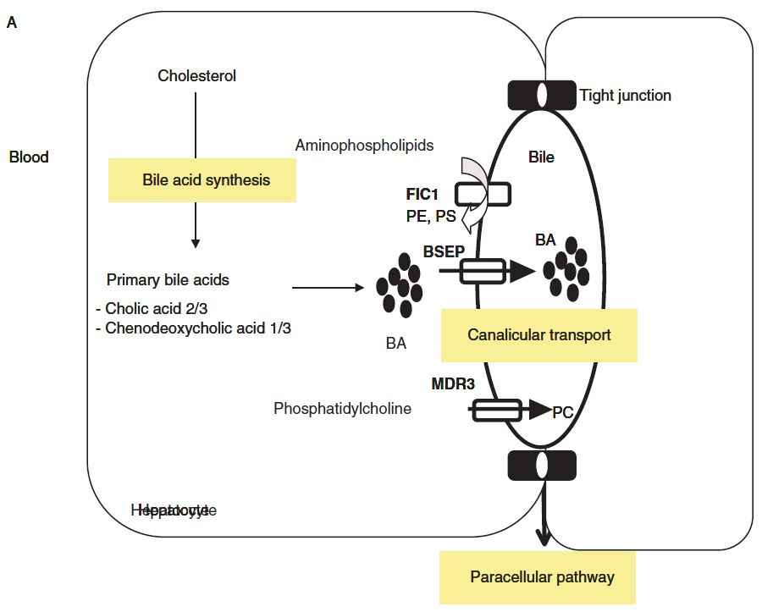

Slide 5
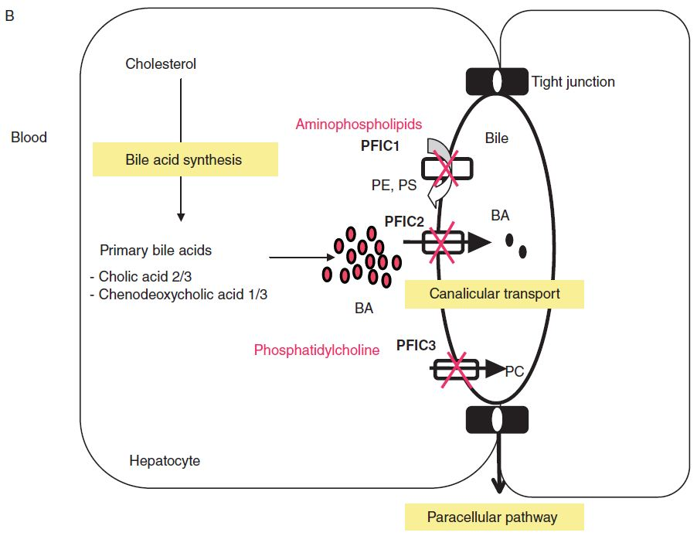

Slide 6
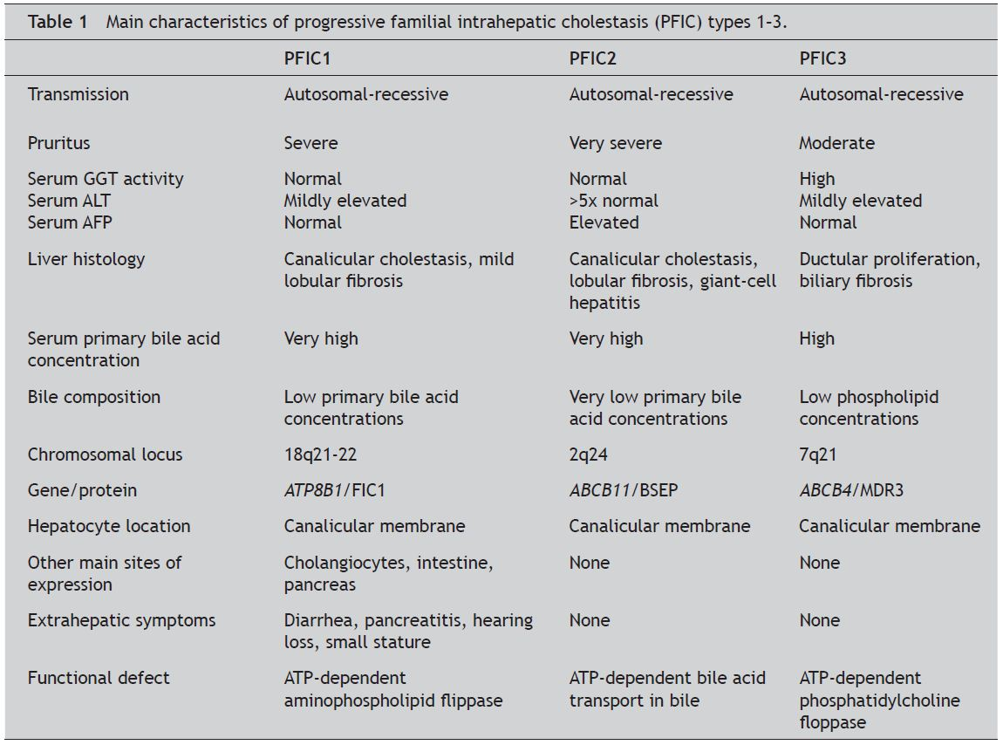

Slide 7
Treatment
UDCA
모든 종류의 PFIC에서 초치료로 사용해 볼 수 있다. PFIC3에서 잘 듣는 경향.
Surgical Biliary diversion
PFIC1,2에서 도움이 될 수 있다.
Liver transplantation
이후의 유일한 방법

Slide 8
Prognosis
Portal HTN, Liver failure, Cirrhosis, HCC
Biliary stones, Drug induced cholestasis, Intrahepatic cholestasis of pregnancy

