Slide 1
Initial Experience of Robot-assisted Resection of Choledochal Cyst in Children
Seok Joo Han
EY Chang, HK Chang, SA Ryu, J Oh
Department of Pediatric Surgery,
Yonsei University College of Medicine
Severance Children Hospital, Seoul, Korea

Slide 2
Backgrounds and Aims
Although the laparoscopic surgery for hepatobiliary disease in children is possible, it is technically challenging due to its high degree of complex.
In an attempt to overcome these difficulties, da Vinci Robotic Surgical System® was used to facilitate the minimally invasive treatment of choledochal cyst in six children
Aim of this study is to report the initial experience of robotic-assisted resection of choledochal cyst in children.

Slide 3
Material and Methods
Retrospective study
Robotic assisted resection of choledochal cyst in Severance Children Hospital from July, 2008 to March, 2011
Recommendation of Robotic surgery
Not complicated choledochal cyst
Explain the advantage and disadvantage of Robotic surgery
Free decision by parents

Slide 4
Material and Methods
Abdominal US and MRCP for anatomical define
da Vinci®(Intuitive Surgical, Sunnyvale, CA) Robotic Surgical System
Intraperitoneal pressure: <12 mm Hg
Jejunojejunostomy:
Intracoporeal: first case
Extracorporeal: later case

Slide 5
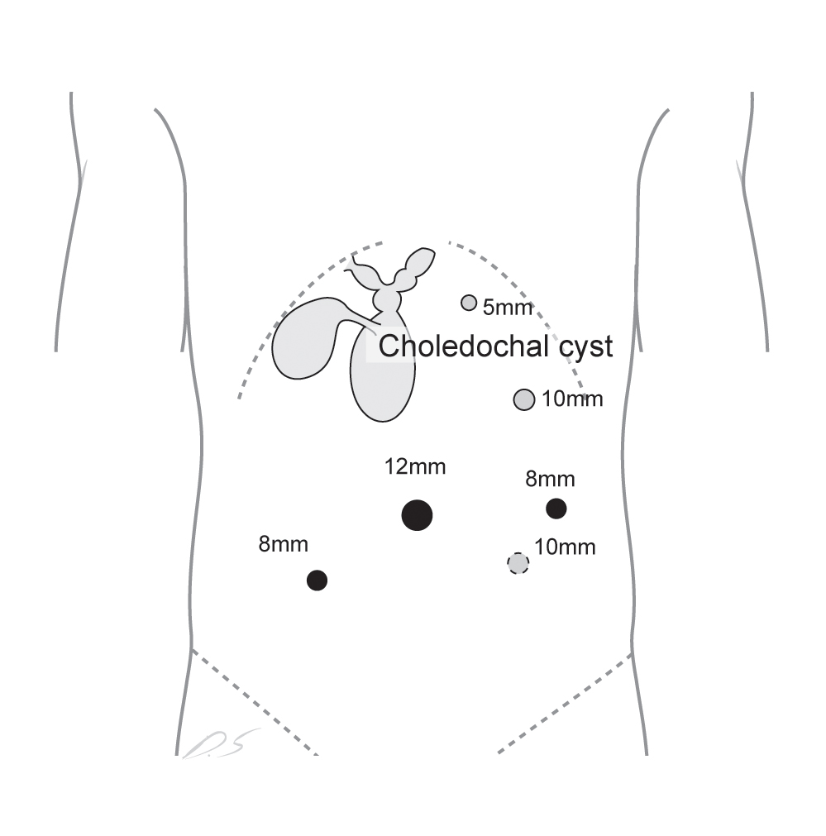
Material and Methods
The 12-mm camera port was inserted with standard umbilical open technique.
Three or two 8-mm working ports were selected based on the size of patients and location of cyst under viewing of the peritoneal cavity.
An accessory 10 mm- or 5 mm-laparoscopic port was placed for the bedside assistant to enable assistance to the robot for the insertion of sutures or additional instruments to retract organs, provide suction, irrigate, or cut sutures as required

Slide 6
Results
Total Number of Resection of choledochal cyst in the study period : 57 cases
Attempts of Robotic resection: 6 cases

Slide 7
Results
Case | Age (y) | Weight (Kg) | Type | Op. time (h) | Morbidity | Postop. stay (d) | Follow-up (m)
1 | 2.8 | 11.7 | Ic | 9.2 | Lapa. | 9 | 35
2 | 14.8 | 39.1 | Ic | 14.6 | St. | 8 | 34
3 | 4.4 | 17.3 | Ic | 11.5 | Leak. | 18 | 10
4 | 3.2 | 15.6 | Ic | 11.6 | No | 8 | 6
5 | 2.3 | 12.0 | Iva | 10.4 | No | 9 | 3
6 | 10.0 | 49 | Ic + FNH | 11.1 | No | 9 | 1
Mean | 6.25 | 22.6 |  | 11.4 |  | 10.2 | 14.6
Table 1 . Summary of the patients treated by robotic-assisted resection of choledochal cyst.
Type: Todani’s classification of choledochal cyst, Lapa.; Laparotomy, St.; stenosis of hepaticojejunostomy,
Leak.; leakage of hepaticojejunostomy, FNH; focal nodular hyperplasia, SD; standard deviation

Slide 8
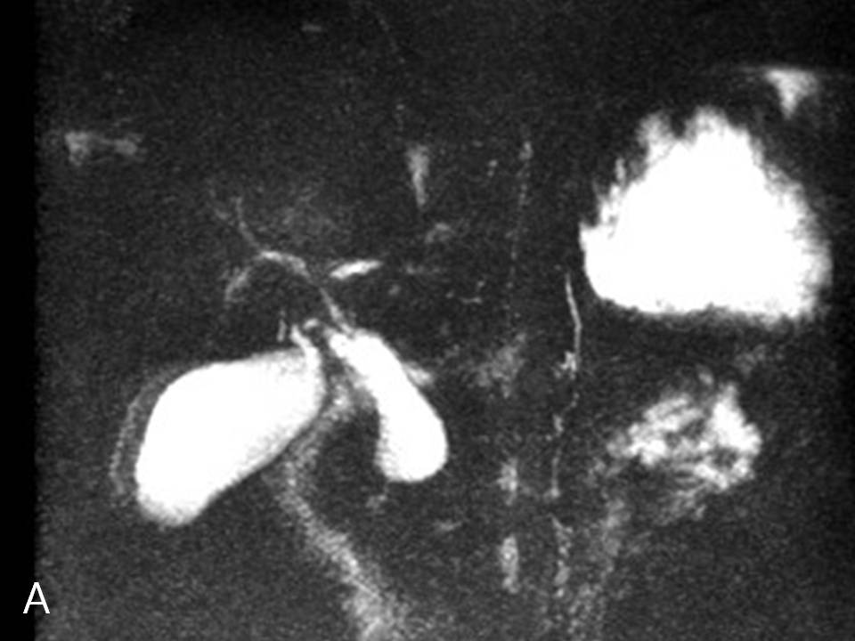
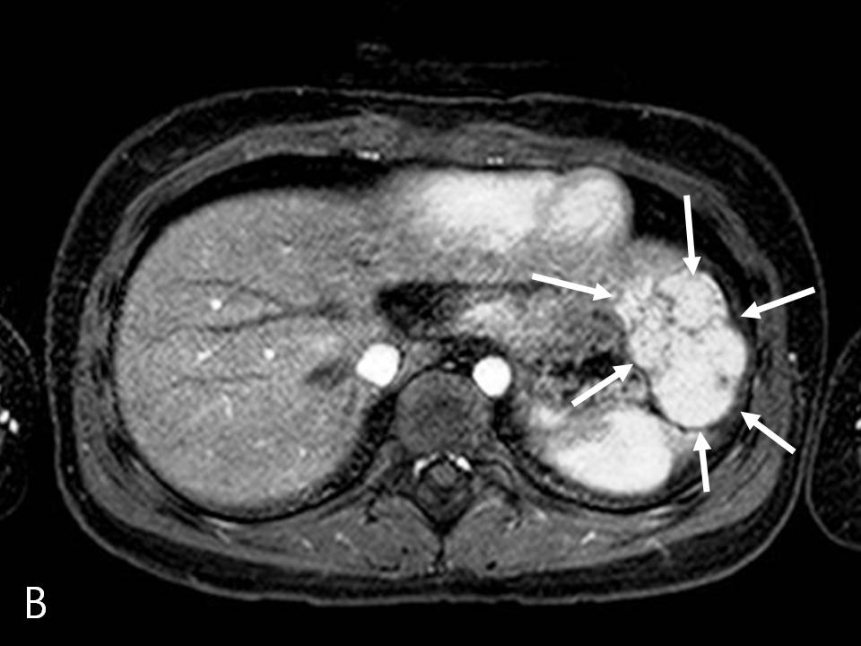
Results
Fig. 1 . Magnetic resonance cholangiopancreaticography in case 6 depicting type Ic choledochal cyst (A) and hepatic mass of left lobe (arrows in B).
Hybrid operation with laparoscopic resection of hepatic mass and robot-assisted resection of choledochal cyst was performed successfully.
The final pathologic diagnosis of hepatic mass was focal nodular hyperplasia.

